Slide 1
Cricket Analysis

Slide 2
Problem Statement
T-20 World Cup 2022 Data Analysis Welcome to the T-20 World Cup 2022 Data Science project. In this endeavor, we'll embark on an exciting journey of comprehensive data analysis, drawing meaningful insights from the action-packed world of T- 20 cricket. We'll dive deep into the dataset, explore the nuances of the game, and provide valuable insights and inferences. Problem Statement: The T-20 World Cup 2022 dataset provides a goldmine of cricket data, including detailed match statistics, player performances, and game-changing events. Your mission is to unravel the stories hidden within this dataset by: 1. Data Exploration: Delve into the dataset to uncover trends, patterns, and insights. Analyze the performance of teams, players, and key events within the matches. 2. In-Depth Analysis: Examine player statistics, including runs, wickets, and over-by-over progress, to understand the dynamics of the game. 3. Event Inference: Identify and analyze critical match events, such as boundaries, wickets, and strategic moments. Uncover the factors that contribute to the success or downfall of a team. 4. Performance Evaluation: Evaluate individual and team performances, including standout players, consistent run-scorers, and top wicket-takers. Discover what sets them apart. 5. Statistical Insights: Utilize statistical techniques to gain insights into team strategies, batting, bowling, and match outcomes. Create visualizations that convey the story of the tournament.

Slide 3
Import Data And Required Packages
import pandas as pd
import numpy as np
import matplotlib.pyplot as plt
import seaborn as sns
import plotly.express as px
import warnings

Slide 4
Data Cleaning and Manipulation
The first stage in any EDA problem solving strategy is Data cleaning and Manipulation stage.
Data Cleaning and Manipulation Steps
Data Understanding
Reading Dataset documentation Importing data - understanding each column data Data Summarisation like Check data type of columns, number of rows etc. Data Cleaning
Dropping irrelevant columns Renaming the columns Dropping the duplicate rows Dropping or handling missing values Dropping invalid data rows (Also check if column have correct data type) Detecting and handling outliers (this can be handled in data analysis part as well) Data Manipulation
Column transformation Joining datasets other manipulation like pivoting or transposing (this is also applied in data analysis part)

Slide 5
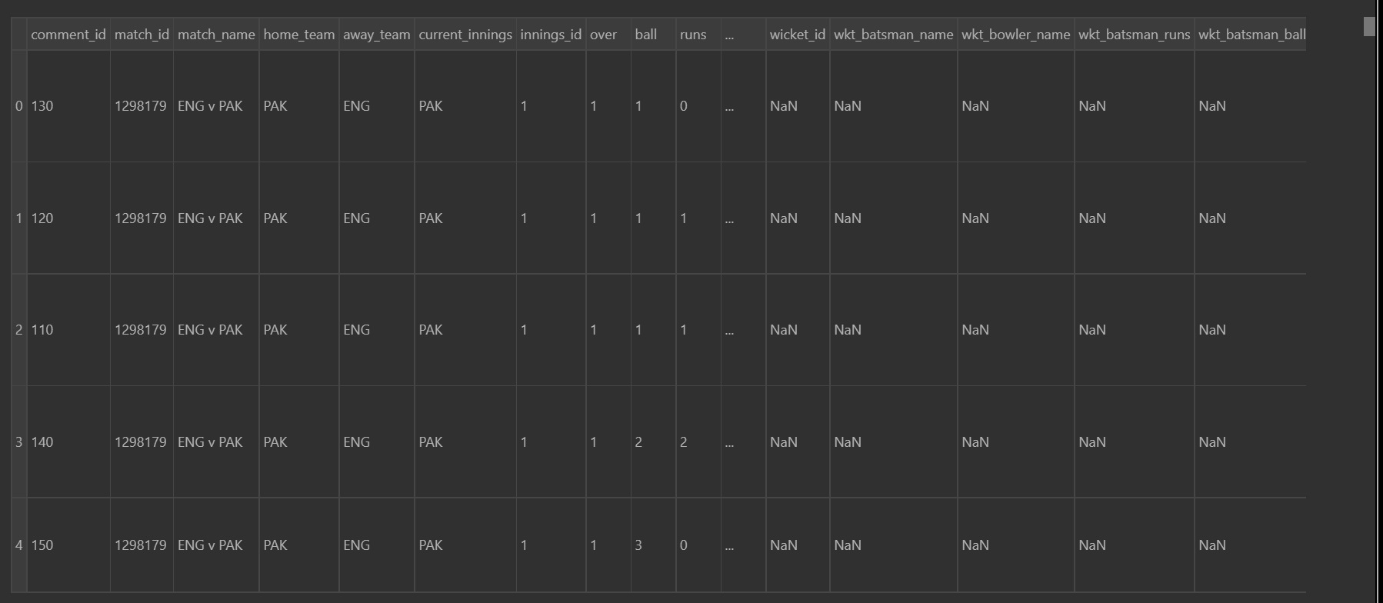
After uploading our data set in google collab by using pandas lib we can see how our data actually look like

Slide 6
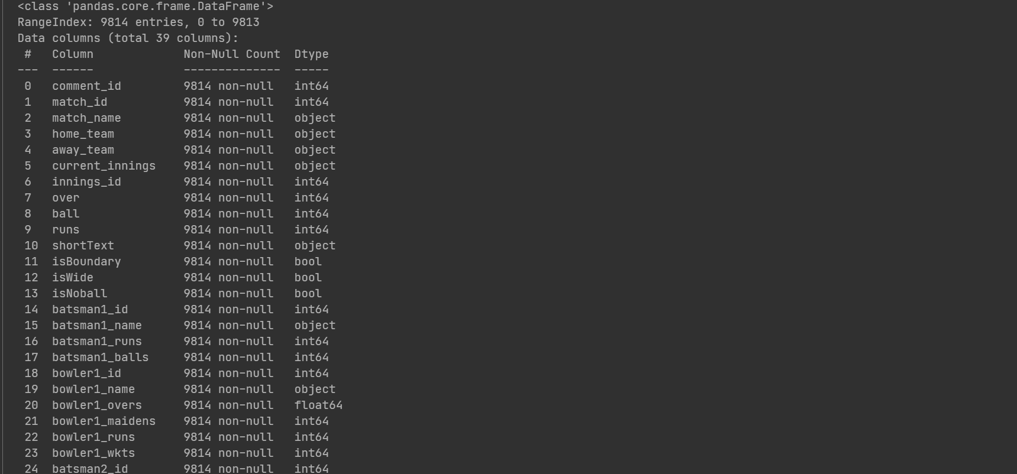
Data Summarisation
What is the shape of the data which means how many row and columns are present in the data it can be done by using pandas.shape
To get the information about the data that is the any null value present in the data or what type of value a column hold

Slide 7
Data Cleaning Required
Drop the Duplicate Values
Drop unnecessary Columns
Fill missing Values
Change data or Time Columns in particular style
Apply some Standarization method to deal with over and underfitting problems
Apply Column Transformation if Required

Slide 8
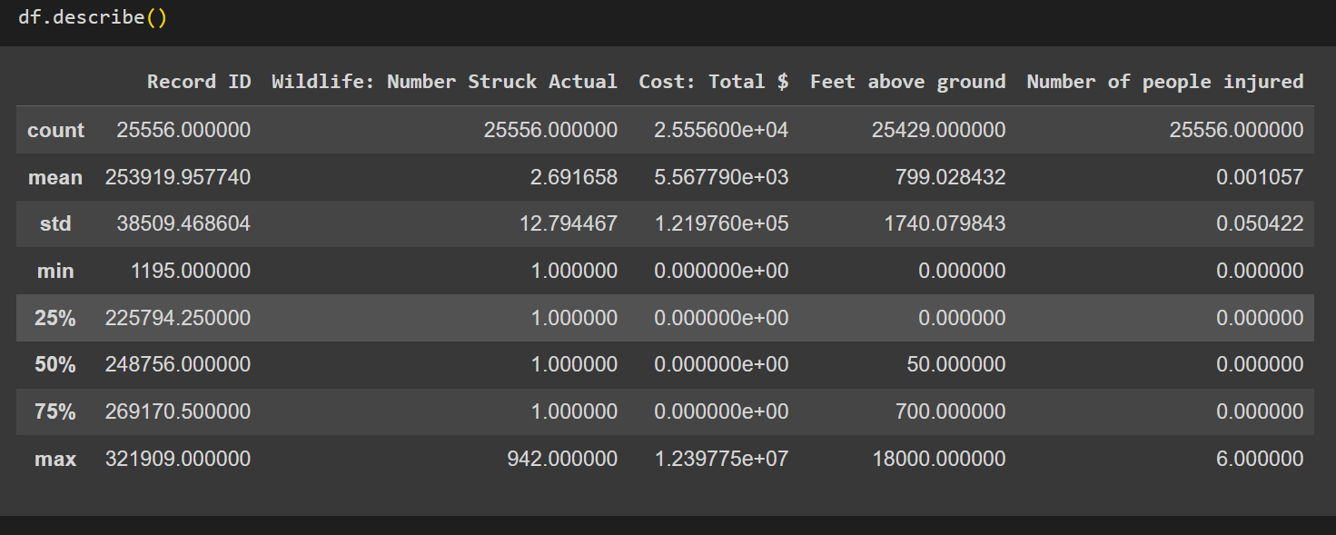
Describe everthing between numerical column in the data set

Slide 9
Data Visualization:
To be a successful leader in the modern finance workplace, you need to be fluent in data analysis and visualization. Data visualization tools help you quickly compare large volumes of data and easily identify patterns that aren’t immediately available in blocks of text. Good data visualization also makes it easier to communicate detailed concepts to other people.¹
There are many ways to share your information as graphical representation—histograms, bar charts, heat maps, pie charts, tree maps, box plots, and word clouds, among others—so you have lots of options when it comes to presenting complex data to diverse audiences.² Keep reading to explore the techniques and tools involved in data analysis and visualization.

Slide 10
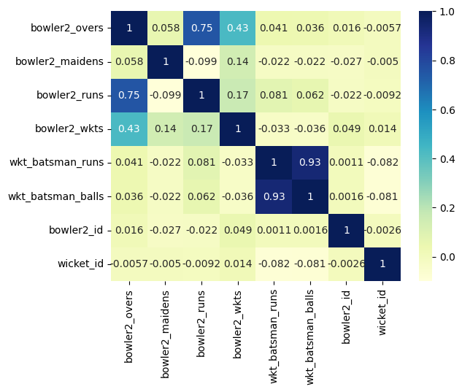

Slide 11
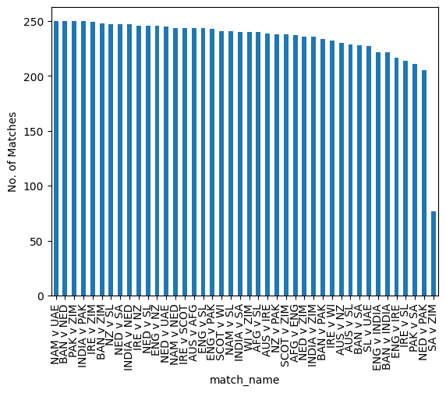

Slide 12
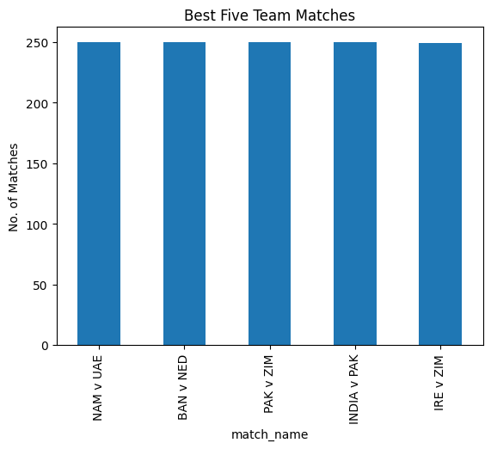

Slide 13
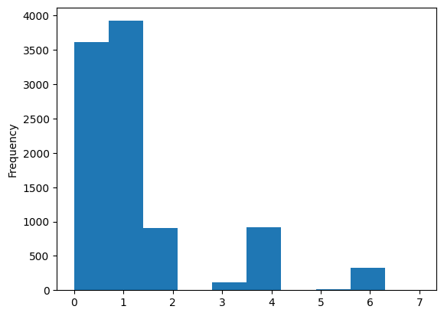
Runs Count:

Slide 14
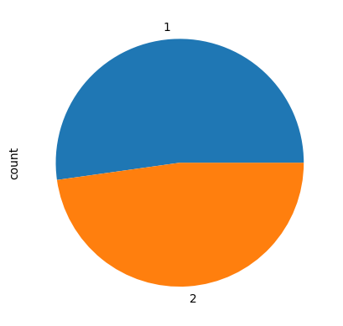
Inning between team according to id’s

Slide 15
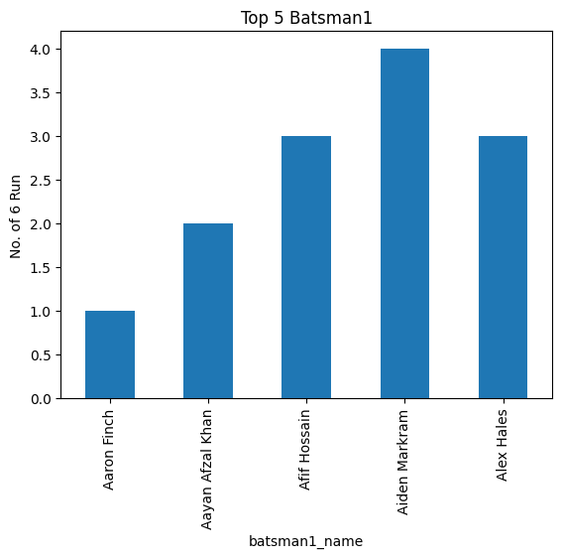

Slide 16
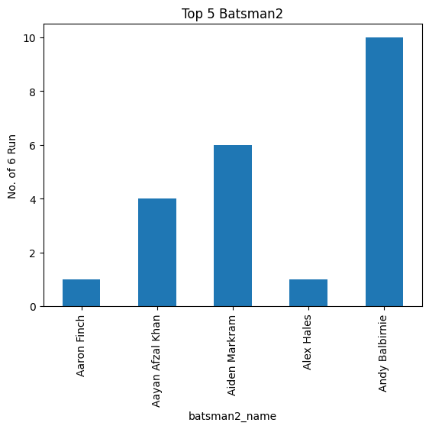

Slide 17
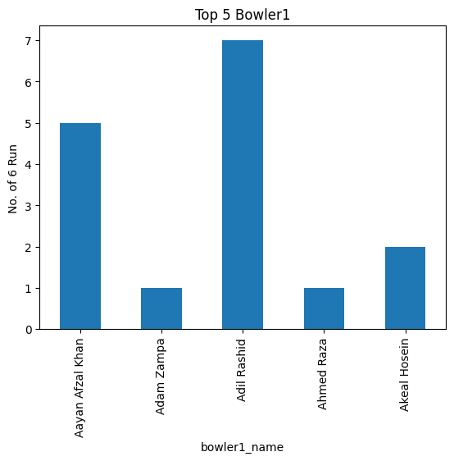

Slide 18
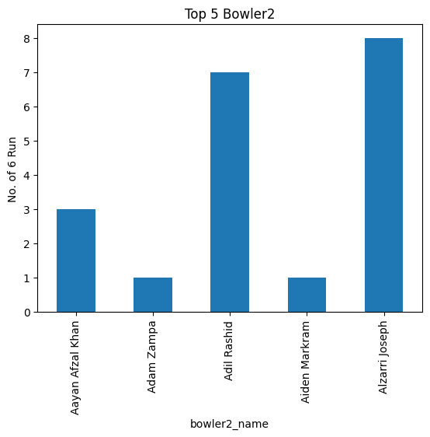

Slide 19
THANKING YOU

